Slide 1
Operation Analytics and Investigating Metric Spike
Preeti Kumari​

Slide 2
AGENDA
Project Description​
Approach
​Tech Stack Used
Insight
​Results

Slide 3
PROJECT DESCRIPTION
Introduction
Operation analytics refers to the use of data and statistical analysis techniques to gain insights and improve the efficiency and effectiveness of various operational processes within an organization. It involves collecting, analyzing, and interpreting data related to operations in order to make informed decisions and drive improvement.
In this project we will discuss two case studies:
Case Study 1 (Job Data)
Case Study 2 (Investigating metric spike)

Slide 4
Contd.
Data Description
CASE STUDY 1
Table-1: job_data
job_id: unique identifier of jobs
actor_id: unique identifier of actor
event: decision/skip/transfer
language: language of the content
time_spent: time spent to review the job in seconds
org: organization of the actor
ds: date in the yyyy/mm/dd format. It is stored in the form of text and we use presto to run. no need for date function

Slide 5
CONTD.
CASE STUDY 2 (INVESTIGATING METRIC SPIKE)
Table-1: users
This table includes one row per user, with descriptive information about that user’s account.
Table-2: events
This table includes one row per event, where an event is an action that a user has taken. These events include login events, messaging events, search events, events logged as users progress through a signup funnel, events around received emails.
Table-3: email_events
This table contains events specific to the sending of emails. It is similar in structure to the events table above.

Slide 6

OBJECTIVES
Find out number of jobs reviewed
Calculate the no. of events happening per second.
Estimating the Percentage share of each language for different contents
Identifying the Duplicate rows
CASE STUDY 2
Measure the activeness of a user
Calculate the amount of users growing over time.
Weekly Retention of Users after signing-up for a product
Weekly Engagement of user.
Email Engagement of Users.
CASE STUDY 1

Slide 7


APPROACH
For case study 1 my approach is find out the following details
Calculate the number of jobs reviewed per hour per day for November 2020?
Calculate 7 day rolling average of throughput
Calculate the percentage share of each language in the last 30 days?
Display duplicates from the table?

Slide 8
APPROACH
For case study 2
Calculate the weekly user engagement?
Calculate the user growth for product?
Calculate the weekly retention of users-sign up cohort?
Calculate the weekly engagement per device?
Calculate the email engagement metrics?

Slide 9

Tech Stack
The tools used in this project are given below:
MYSQL which is an open-source database management system. It
is mainly used for Exploratory data analysis purpose.

Slide 10
INSIGHTS
CASE STUDY 1

Slide 11

Number of jobs reviewed per hour per day for November 2020?
number_of_jobs_reviewed_per_day_non_distinct
0.0111
number_of_jobs_reviewed_per_day_distinct
0.083

Slide 12
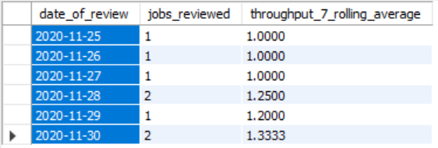
Calculate 7 day rolling average of throughput ( Non Distinct)

Slide 13
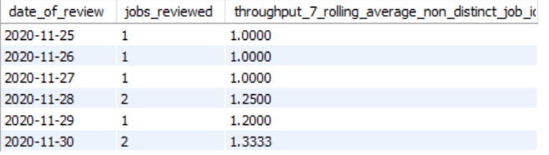
Calculate 7 day rolling average of throughput (Distinct)

Slide 14
Calculate the percentage share of each language in the last 30 days(Distinct)
Job_id | language | Total_of_each_language | Percentage_share_of_each_distinct_langugage
21 | Arabic | 1 | 12.5
22 | English | 1 | 12.5
23 | French | 3 | 12.5
25 | Hindi | 1 | 12.5
11 | Italian | 1 | 12.5
20 | Persian | 1 | 37.5

Slide 15
Calculate the percentage share of each language in the last 30 days (Non -Distinct)
Job_id | language | Total_of_each_language | Percentage_share_of_each_langugage
21 | English | 1 | 12.5
22 | Arabic | 1 | 12.5
23 | Persian | 3 | 37.5
25 | Hindi | 1 | 12.5
11 | French | 1 | 12.5
20 | Italian | 1 | 12.5

Slide 16

Display duplicates from the table

Slide 17
INSIGHTS
CASE STUDY 2

Slide 18

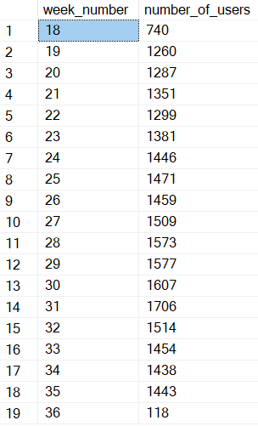
Calculate the weekly user engagement?

Slide 19
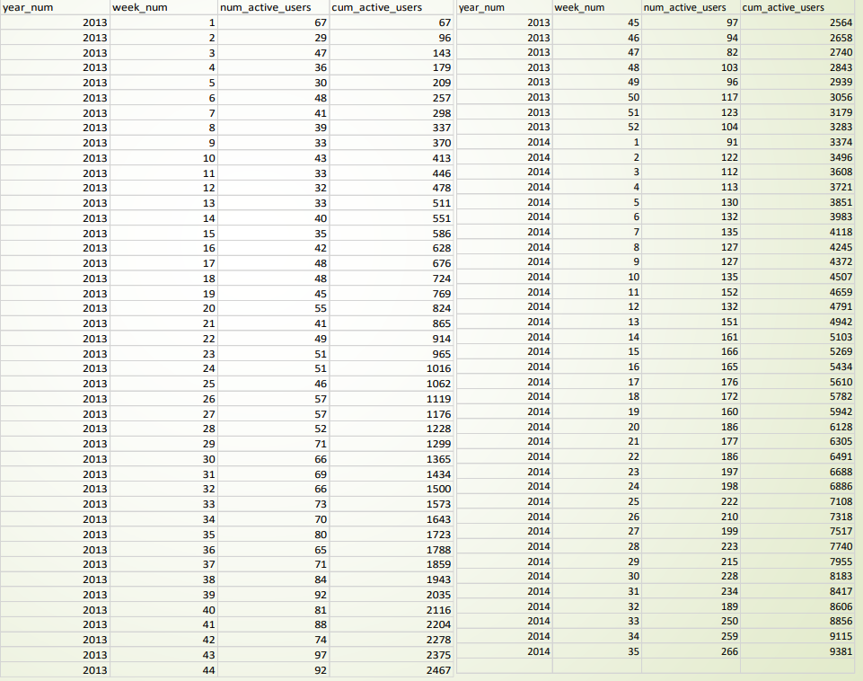
Calculate the user growth for product?

Slide 20

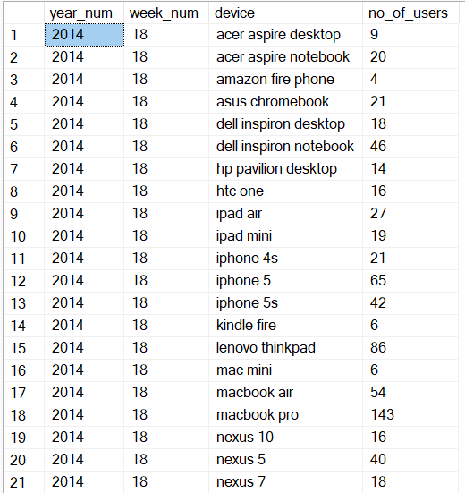
Calculate the weekly engagement per device?
There are 491 records
Week from 18-36 in year 2014

Slide 21


Calculate the email engagement metrics?

Slide 22
Results
It provides valuable insights and data-driven information that support decision-making processes.
It helps to identify bottlenecks, inefficiencies, and areas for improvement within operational processes.
It aids in quality control by monitoring and analyzing data related to product or service quality.
This furthur helps organizations understand customer behavior, preferences, and satisfaction levels.

Slide 23
THANK YOU

